Slide 1
Solidification
When molten metal enters a mold cavity, its heat is transferred through the mold
wall. In the case of pure metals and eutectics, the solidification proceeds layer-by-
layer (like onion shells) starting from the mold wall and proceeding inwards. The
moving isothermal interface between the liquid and solid region is called the
solidification front. Solidification includes two processes: nucleation and growth.
1- Nucleation and Growth
When liquid metal is poured into a mold and allowed to cool, a series of complex
events takes place. The significant factors are the type of metal (whether it is a
pure metal or an alloy), thermal properties (thermal conductivity and specific heat),
the geometric relation between volume and surface area of the liquid metal, the
shape of the mold, and the mold material. Many casting defects, such as porosity
and cavities, depend on the manner in which the alloy is solidified in a mold.
Basically the reason of molten metal solidification is that the arrangement of the
atoms in the solid crystal is at a lower free energy than that of the same atoms in a
liquid state. Above the freezing point, however, the liquid state is more stable. At
the freezing point there is no driving force in either direction; in other words, the
change in free energy is zero, and we have equilibrium. The further the metal is
cooled below the liquid-solid equilibrium temperate, the greater is the driving force
to solidify. The first step of solidification is the nucleation, and there are two types
of nucleation: „homogenous and heterogeneous'.
1

Slide 2
Homogenous Nucleation
The temperature at which homogenous nucleation occurs is always below the
equilibrium freezing point because it is necessary to overcome the surface-tension forces which impede nucleus growth. The energy tending to produce a nucleus of solid is the difference in free energy per unit of volume between the liquid and solid phases.
In the general case of freezing within the bulk of pure molten metal, minute
crystalline nuclei form independently at random points. After this homogeneous
form of nucleation, continued removal of thermal energy from the system causes
these nuclei to grow independently at the expense of the surrounding melt.
Throughout the freezing process, there is a tendency for bombardment by melt
atoms to destroy embryonic crystals; only nuclei which exceed a critical size are
able to survive. Rapid cooling of pure molten metal reduces the time available for
nuclei formation and delays the onset of freezing by temperature interval of (ΔT).
This thermal under-cooling (or suppercooling), varies in extent, depending upon
the metal and conditions, but can be as much as (0.1- 0.15) Tm, where Tm is the
absolute melting point. However, commercial melts usually contain suspended
insoluble particles of foreign matter (e.g. from the refractory crucible or hearth)
which act as seeding nuclei for so-called heterogeneous nucleation. Undercooling
is much less likely under these conditions. Homogeneous nucleation is not
encountered in normal foundry practice.
Heterogeneous Nucleation
Most actual castings crystallize by heterogeneous nucleation, the basic reason
being that if the new phase can find a foreign particle to grow upon, it can in effect adopt the relatively large radius of the particle as its own. This means that only a
2

Slide 3
slight degree of super cooling is needed in comparison with that needed in
homogeneous nucleation. Quantitatively, the relation depends upon the degree to
which the new phase “wets” the foreign particle. If there is no attraction between
the atoms of the foreign particle and those of the precipitating phase, then
nucleation is not helped. The wall of a mold usually provides many heterogeneous
nucleation sites. The best nucleus, of course, is a particle of the precipitate itself.
For example, it is possible to grow large single crystals of metals by introducing a
small crystal of the metal itself into a melt as it cools through the freezing
temperature.
Growth
The growing crystals steadily consume the melt and eventually impinge upon each
other to form a structure of grains. During the freezing of many metals (and
alloys); nucleated crystals grow preferentially in certain directions, causing each
growing crystal to assume a distinctive, non-faceted tree-like form known as a
dendrite. As each dendrite spike grows, latent heat is transferred into surrounding
liquid, preventing the formation of other spikes in its immediate vicinity. The
spacing of primary dendrites and dendrite arm therefore tends to be regular.
Ultimately, as the various crystals impinge upon each other, it is necessary for the
interstices of the dendrites to be well-fed with melt if inter-dendritic shrinkage
cavities are to be prevented from forming.
Solidification of Metals and Alloys
The solidification divided into three types:
1-At constant temperature (pure metals and eutectic alloys)
3

Slide 4
2-Over a temperature range (solid solutions)
3-By a combination of solidification over a temperature range followed by constant
temperature freezing (proeutectic-plus eutectic type freezing).The solidification process differs depending on whether the metal is a pure element or an alloy.
Solidification of Pure Metals
A pure metal solidifies at a constant temperature equal to its freezing point, which
is the same as its melting point. The melting points of pure metals are well known
and documented. The process occurs over time as shown in the plot of figure (A),
called a cooling curve. The actual freezing takes time, called the local
solidification time in casting, during which the metal's latent heat of fusion is
released into the surrounding mold. The total solidification time is the time taken
between pouring and complete solidification. After the casting has completely
solidified, cooling continues at a rate indicated by the downward slope of the
cooling curve.
Solidification of Alloys
Most metals used for technical applications are alloys, i.e., mixtures composed of
several chemical components. The solidification of alloys differs in three principal ways from that of pure metals:
1-Usually, the freezing of alloys occurs over a temperature range.
Most alloys freeze over a temperature range rather than at a single temperature.
The exact range depends on the alloy system and the particular composition.
Solidification of an alloy can be explained with reference to figure (B) which
shows the phase diagram for a particular alloy system and the cooling curve for a
given composition. As temperature drops, freezing begins at the temperature
4

Slide 5
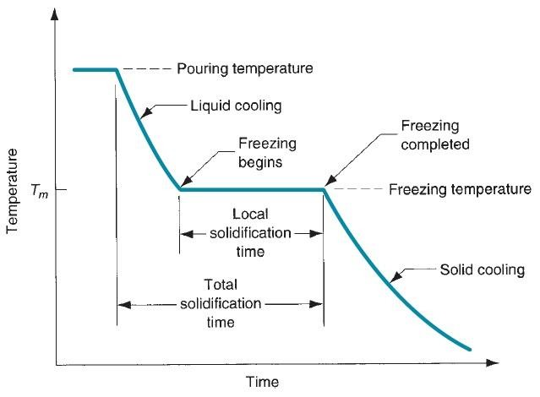
indicated by the liquidus and is completed when the solidus is reached. The start of
freezing is similar to that of the pure metal.
2-The composition of the solid which separates first is different from that
liquid.
of
the
3-There may be more than one solid phase crystallizing from the liquid.
Figure ( A) Cooling curve for a pure metal during casting
Solidification Mode
Alloys can be classified into three types based on their freezing ranges:
• Short freezing range : liquidus- to- solidus interval < 50ºC
• Intermediate freezing range : interval of 50 to 110ºC
5

Slide 6
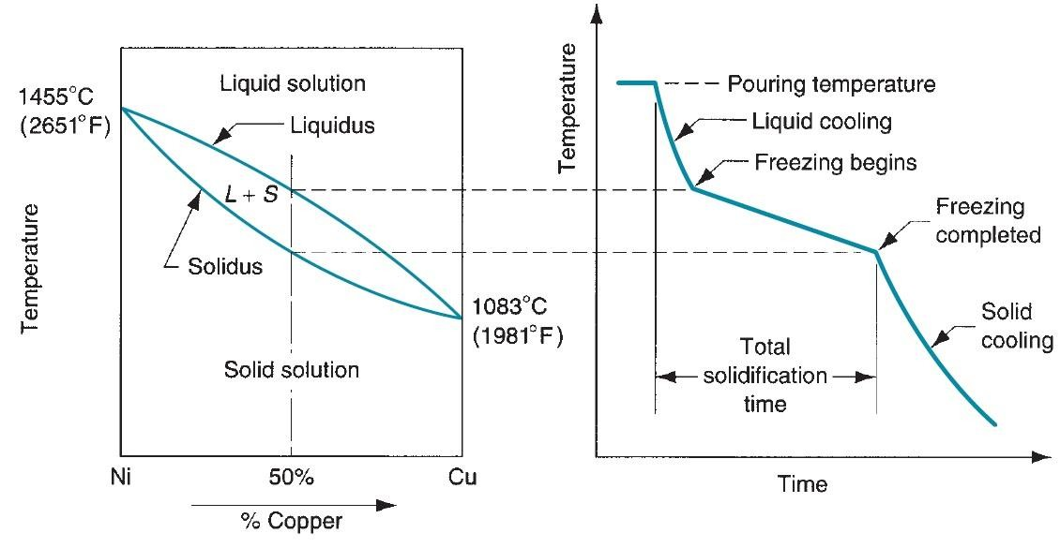
• Long freezing range : interval > 110ºC
Figure (B) (a) Phase diagram for a copper-nickel alloy system and (b) associated cooling
curve for a 50%Ni-50%Cu composition during casting.
The first group consists of the pure metals and alloys which are 100% eutectic, in
which the
freezing range approaches zero, the solidifying
casting wall
(solidification front) progresses inward as a plane front and is almost smooth as
shown in figure (C). Short freezing range alloys are closely similar but in these
instances the front is not perfectly plain but is serrated as illustrated in figure (D),
which shows a strong tendency toward skin formation, and the front of the crystals
solidifying inward (start of freeze) will not advance much faster than their bases
(end of freeze). Such relative, short crystalline growth helps keep liquid feed metal
in contact with all solidifying surfaces. Such strong progressive solidification in
these short freezing range alloys promotes the development of directional
solidification along any temperature gradients in the solidifying casting figure (D).
6

Slide 7
For long freezing range alloys, the development of directional solidification is
difficult. Although a thin skin may initially form on the mold walls, almost as soon
as the crystallites are formed, their growth becomes drastically inhibited. The first-
formed crystals are much lower in alloying elements than the liquid metal from
which they are formed. Hence many of the atoms of alloying elements present in
the liquid metal from which crystallites are formed are expelled into the liquid
surrounding the crystallites. These surrounding liquids thus become enriched in
alloying element and this enrichment considerably depresses the freezing point of
the liquid. If freezing were very slow, so that ample time is available for diffusion
of the excess atoms from this enriched layer of liquid into remainder of the liquid
metal, the crystallites would continue to grow and a columnar structure would
result. However, in most practical situations there is not nearly sufficient time for
these concentrations in the liquid to be dissipated by diffusion so that the liquid
metal surrounding the crystallites is unable to freeze till a much later stage during
freezing of the casting as a whole. As illustrated in figure (E), the material at first
being fluid, then mushy and finally rigid, It has been estimated that in many alloys,
rigidity is not established until the casting is about 60-70% solid. This mushy or
pasty mode of solidification results in the development of numerous small channels
of liquid metal late in solidification. Feeding through these channels is restricted,
and dispersed shrinkage porosity occurs throughout the casting. For alloys with an
intermediate freezing range, the mode of solidification will combine elements of
both the skin-forming and mushy solidification mode as shown in figure (F). Short
freezing range alloys may shift to a more intermediate mode of solidification in
heavy casting section, in which heat loss from the casting surface will be slowed as
the molding medium heats up.
7

Slide 8
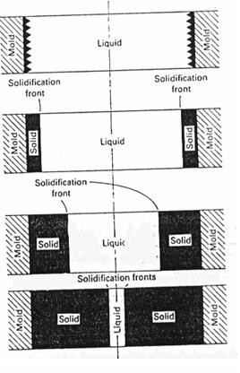
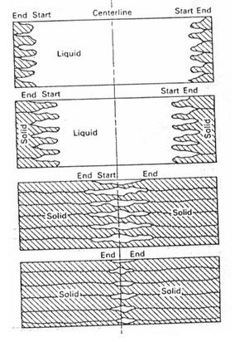
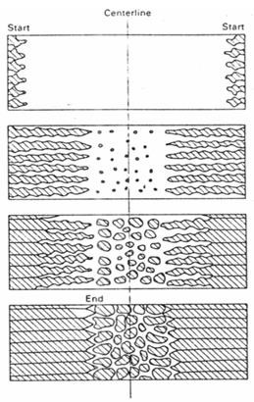
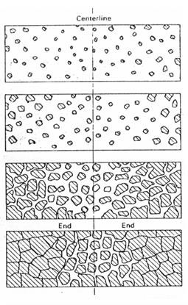
Fig.(C) Mode of Pure Metal
Fig .(D) Short Freezing Range
Fig. (E) Intermediate Freezing Mode
Fig. (F) Long Freezing Mode
8

